Slide 1

Back End Engineering-I
Project Presentation
Semester-IV(Batch-2023)
MEDICARE
Supervised By : Submitted By:
Ms. Vijaita Kashyap Moksh , 2310992072 Ishneet , 2310992019
Department of Computer Science and Engineering
Chitkara University Institute of Engineering & Technology,
Chitkara University, Punjab
1

Slide 2
Abstract
The Medicare Hospital Management System is a comprehensive backend solution designed to enhance the efficiency and effectiveness of hospital operations. This project focuses on streamlining patient management, appointment scheduling, staff coordination, and resource allocation through an intuitive, centralized platform. Built using modern backend technologies, the system integrates essential features such as patient registration, appointment booking, staff management, and medical record tracking. It leverages Node.js for the server-side architecture, enabling seamless data flow and interaction between the front-end and database. The system handles data using RESTful APIs, ensuring secure and efficient communication through HTTP GET and POST requests. Data persistence is achieved through a structured database, where information related to patient details, appointments, and medical histories is stored and retrieved dynamically. The hospital management platform aims to solve real-world challenges, such as reducing manual errors, improving patient service quality, and optimizing hospital workflows. With features like real-time scheduling, automated notifications, and a streamlined interface for both administrative staff and healthcare professionals, the system ensures smooth hospital operations. This project serves as a analytics, reporting modules, ultimately contributing to the modernization and digital transformation of healthcare management.
2

Slide 3
Table of Contents
1. Problem Statement
2. Objectives
3. Proposed Solution
4. Output
5. Conclusion
6. Future Scope
3

Slide 4
Problem Statement
In many healthcare facilities, patient management and hospital operations are still handled manually, leading to inefficiencies, errors, and delays in critical processes such as appointment scheduling, patient data retrieval, and staff coordination. Hospital staff often struggle with managing large volumes of patient information, which can result in lost medical histories, double-booked appointments, and miscommunication between departments. Furthermore, hospitals lack a centralized system for tracking resources, making it difficult to allocate rooms, equipment, and staff efficiently. These challenges not only affect the quality of care provided to patients but also lead to operational inefficiencies, increased administrative workload, and reduced patient satisfaction.
Inefficient Patient Records
Manual record-keeping causes delays and errors in accessing critical patient information.
2. Data Synchronization Gaps
Lack of real-time data sharing leads to outdated or incomplete information across departments.
3. Poor Patient Follow-Up
Absence of automated reminders and tracking results in missed care opportunities and lower patient engagement.
4

Slide 5

Objectives
Some of the Objectives are given below :
1
Efficient Data Storage and Retrieval
Develop a Node.js backend to securely store and manage customer data in JSON format for efficient access and updates.
2
Streamline Backend Operations
Handle HTTP POST and GET requests to enable seamless communication between the frontend and backend.
Ensure Data Security Compliance
3
Implement strong backend systems to safeguard patient information, ensuring compliance with healthcare data protection regulations.
3
4
Support Personalized Engagement
Utilize stored data to identify returning customers and generate customized offers, improving customer retention and loyalty.
5
5

Slide 6
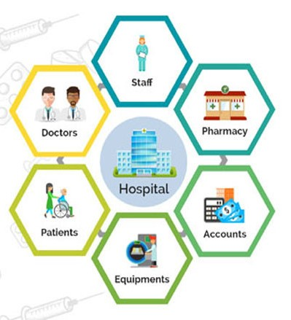
Proposed Solution
1. Secure Data Management System
Develop a Node.js server to handle patient data storage and management, ensuring secure and efficient data retrieval with proper encryption for sensitive information.
2. Automation of Hospital Operations
Automate appointment bookings, patient inquiries, and data management through efficient server-client communication, minimizing manual errors and improving operational efficiency.
3. Personalized Patient Engagement
Utilize stored patient data to identify returning individuals and provide personalized care reminders, offers, and follow-up, improving patient satisfaction and loyalty.
6

Slide 7
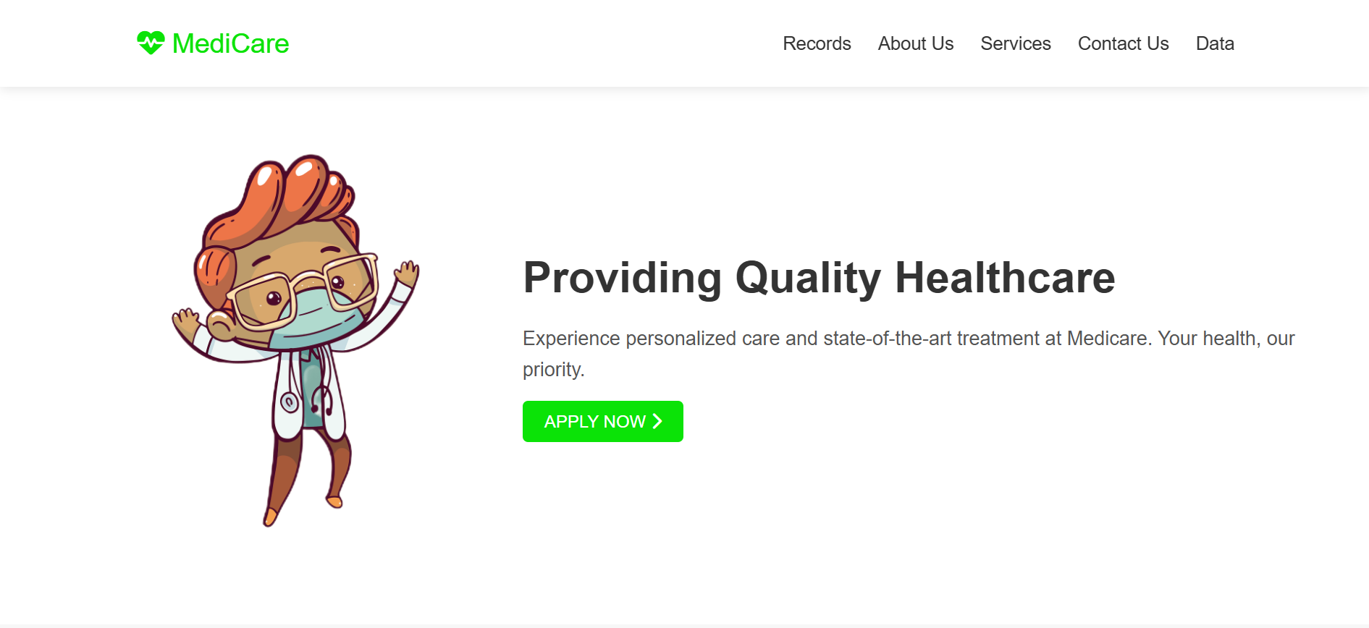
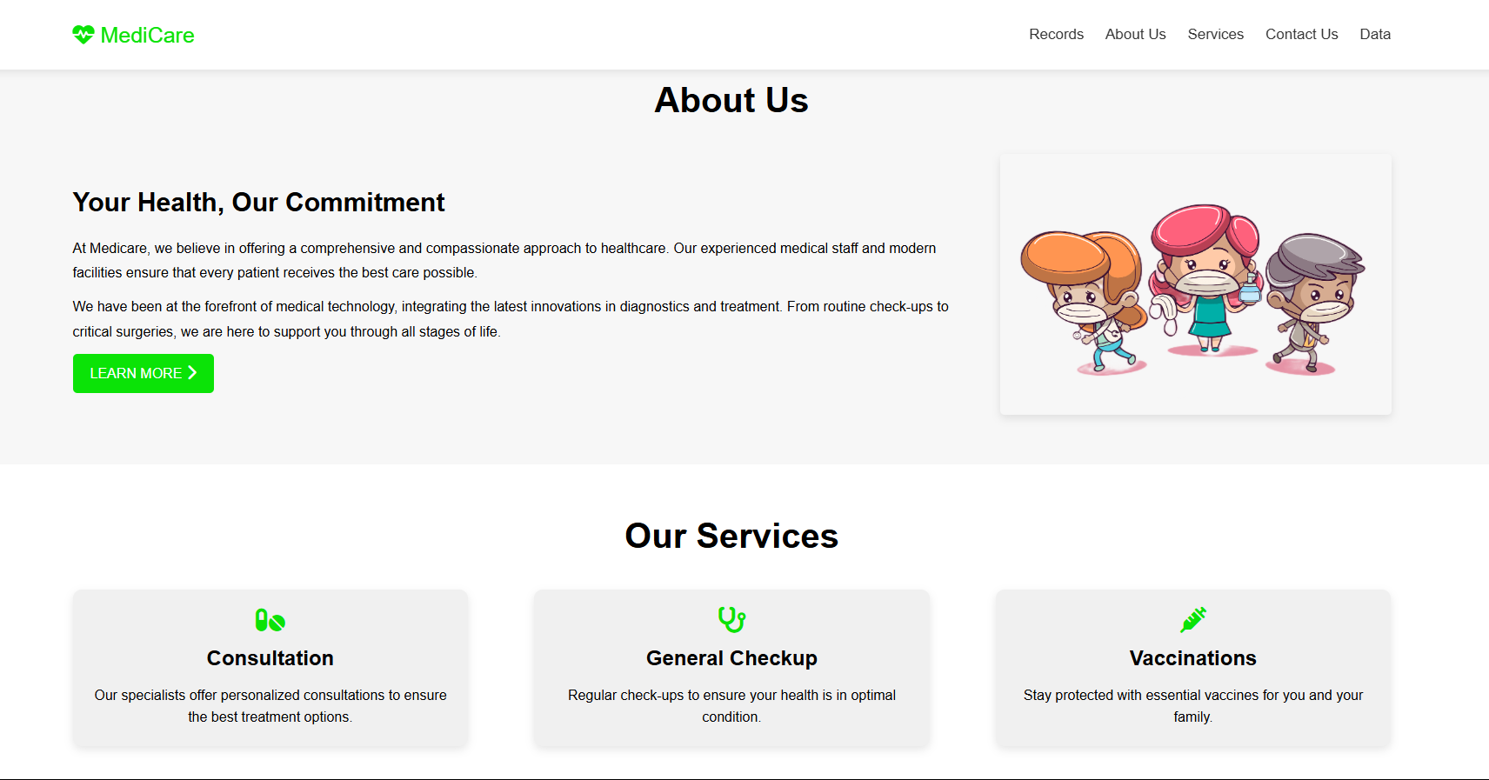
Output
Fig.1 Home Page

Slide 8
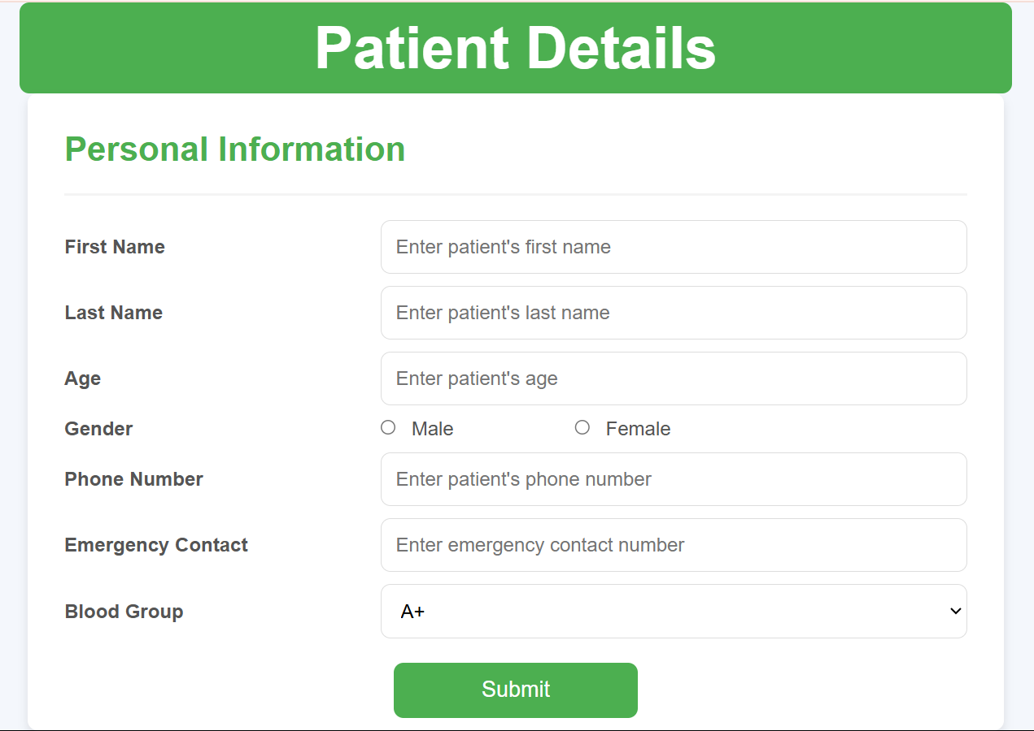
Output
Fig. 2 Details Form

Slide 9
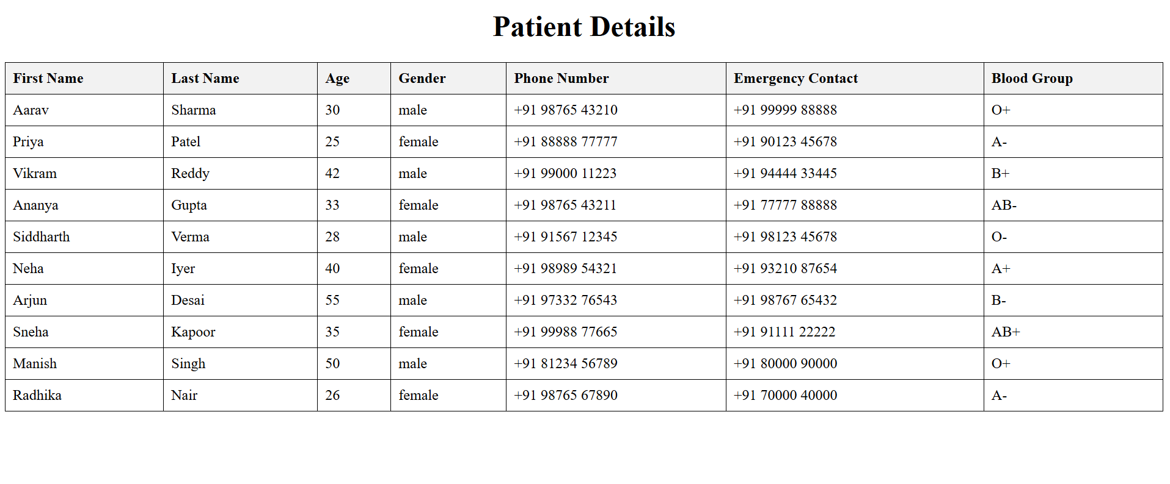
Output
Fig. 3 Displaying the Data

Slide 10
Conclusion
Medicare hospital management system successfully tackles the complexities of hospital operations by integrating a secure, efficient backend infrastructure powered by modern technologies. The system enhances patient care by streamlining processes such as patient registration, appointment scheduling, and medical record management, ensuring that healthcare professionals can focus on providing high-quality care. With the added benefit of personalized patient interactions through stored medical data, the system fosters better patient engagement and satisfaction. Moreover, its scalable architecture and seamless communication between various hospital departments ensure that the system can evolve with future advancements in healthcare technology, positioning it as a comprehensive solution for modern hospital management.
10

Slide 11

Future Scope
The Medicare Hospital Management system aims to evolve into a comprehensive healthcare platform by integrating advanced features such as predictive analytics for patient outcomes, real-time notifications for appointment reminders, and automated clinical decision support. The system will also include modules for managing patient history, treatment plans, and telemedicine consultations.

Slide 12
Thank You
12

